Slide 1
Web Structure Mining
Web and Social Network Analysis Practical - 06

Slide 2





Slide 3
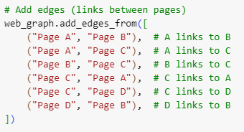

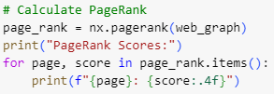


Slide 4

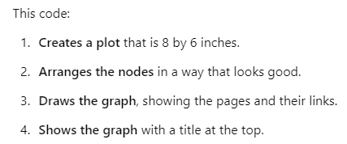

Slide 5
